Slide 1
Classic Elemental
An introductory perspective

Slide 2
Part 1 Intro - The basics

Slide 3
What is Rancher Elemental?
Immutable OS Management Platform - Toolkit for building and managing immutable Linux distributions at scale
Cloud-native approach to bare metal and edge infrastructure provisioning
Integration with Rancher - Extends Rancher's Kubernetes management to the OS layer
Based on SUSE Immutable OS - Built on SL(E) Micro for enterprise reliability and security
Designed for modern workloads - Perfect for edge computing, IoT, and distributed infrastructure

Slide 4
How does Elemental work?
Under the hood
Multiple Boot Methods - Machines can boot from custom ISO images containing registration logic or from raw disk images written directly to storage devices
Automatic Registration - Systems self-register with Rancher management cluster upon first boot
Declarative Configuration - Infrastructure defined through Kubernetes CRDs (MachineRegistration, SeedImage)
TPM Integration - Hardware security module support for secure device identity and attestation

Slide 5
What is the purpose of Elemental?
Zero-touch provisioning - Eliminate manual OS installation and configuration processes
Immutable infrastructure - Prevent configuration drift and ensure consistent system states
GitOps workflow - Manage OS updates and configurations through version control
Edge at scale - Deploy and manage thousands of edge nodes from central location
Lifecycle management - Handle the complete OS lifecycle from deployment to decommissioning

Slide 6
Architecture
Kubernetes-native - Uses Custom Resource Definitions (CRDs) for all management operations
Container-based OS - System runs entirely from container images for consistency
Cloud-init integration - Leverages standard cloud-init for system initialization and customization
Fleet integration - Built-in GitOps capabilities through Rancher Fleet for configuration management
Multi-architecture support - Production support for AMD64/x86_64, ARM64 in development, and experimental RISC-V64 support for emerging hardware platforms

Slide 7
Topics to cover today
All files for today’s demo can be found here: https://github.com/Gagrio/suse-support-material/tree/master/Elemental/Demo
Machine Registration and image creation
Inventory management in action (UI based)
Image configuration with cloud init / cloud config
Custom image creation

Slide 8
Part 2
Demos

Slide 9
Machine registration and image creation
A basic example

Slide 10
Basic Phone Home Scenario
What you need?
A rancher cluster
Elemental operator installed with CRDs https://elemental.docs.rancher.com/installation
Network connectivity & name resolution between rancher cluster and target machines
Automatic Registration of VM to existing Rancher Elemental

Slide 11
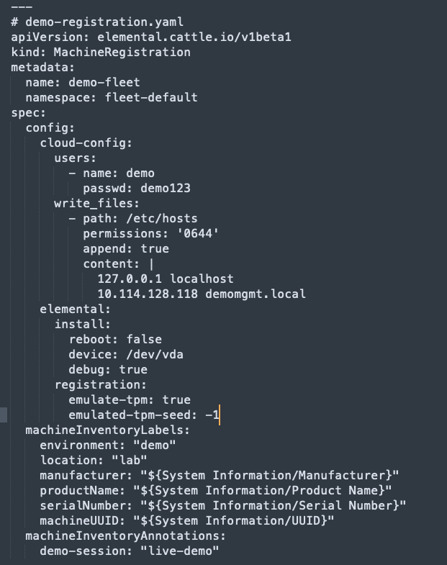
Basic Phone Home Scenario
Example machine registration file (will share in screen)
Automatic Registration of VM to existing Rancher Elemental

Slide 12
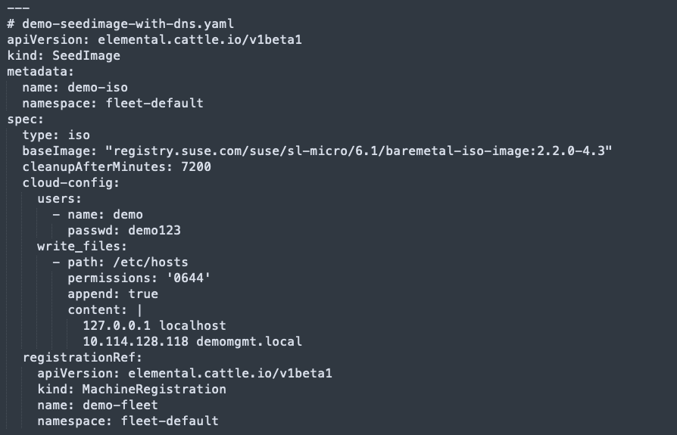
Basic Phone Home Scenario
Example seed image file (will share in screen)
Automatic Registration of VM to existing Rancher Elemental

Slide 13
How that works?
Create & apply yaml files
Observe and validate image creation
Copy/export image to VM platform
Spin up VM(s) and monitor the automatic registration
kubectl apply -f demo-registration.yaml
kubectl apply -f demo-seedimage.yaml
kubectl get pods -n fleet-default | grep demo
kubectl port-forward -n fleet-default pod/demo-iso 8080:80 --address=0.0.0.0 &
curl http://10.114.128.118:8080/
journalctl -f -u elemental-register-install

Slide 14
Inventory management
Well more of inventory display and sorting

Slide 15
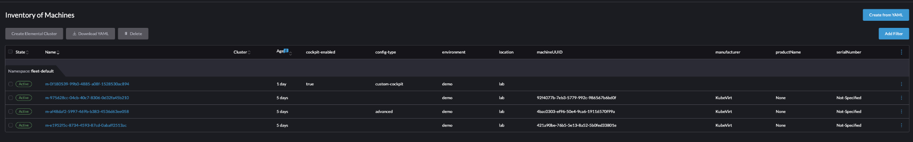
Labels and Annotations
Example screenshot:
On screen - live demo

Slide 16
Image configuration
With cloud init / cloud config

Slide 17
Cloud-init configuration
Let’s go through the files together on the screen.
This example:
Adds root user
Adds admin user with bash shell and ssh key
Creates custom hosts file
Creates custom motd file
Adds user admin to sudoers
Changes root user password via runcmd
Displays the ip of the machine via hostname -I
Both for machine registration and seed image files - live demo

Slide 18
Custom image creation
Create a custom image that has cockpit already installed and enabled

Slide 19
Custom image creation
In this demo we will create a custom image that:
Will spin up a registered SL Micro 6.1 VM
The VM will have cockpit installed and running
There will be a custom label for cockpit
There will be a root user with pass set up
There will be a custom motd
Custom image with cockpit service enabled - live demo

Slide 20
Custom image creation
How this works / what we need:
Multi-stage Dockerfile. It handles the registration and customization on the OS build level, as well as the ISO creation on the build level. In the end, it packages the ISO in a minimal busybox container for easy distribution and extraction. Note: The busybox container serves as a simple wrapper that contains the ISO file and provides a minimal execution environment to copy the ISO contents to a volume. Specifically, the images with -iso-image suffix contain "a pre-built ISO image and a busybox system to be able to copy the contents to a volume"
Podman for validating and saving the image locally and/or pushing to container registry.
Ctr for adding the image to the containerd store on the k8s cluster.
A machineRegistration to customize the rest
A seedImage to create an ISO from the container image we created.
Custom image with cockpit service enabled - live demo

Slide 21
How that works?
Create container image from Dockerfile
Export/save image locally
Add image to containerd store or use external container registry
Use image in seedimage
export SUSE_REGISTRATION_CODE="YOUR_ACTUAL_REGISTRATION_CODE_HERE" podman build \
--build-arg SUSE_REGISTRATION_CODE=$SUSE_REGISTRATION_CODE \
--build-arg IMAGE_REPO=demo/custom-cockpit-iso \
--build-arg IMAGE_TAG=v1.0.0 \
--build-arg TARGETARCH=x86_64 \
-t demo/custom-cockpit-iso:v1.0.0 \
-f Dockerfile \.
.
podman save demo/custom-cockpit-iso:v1.0.0 -o custom-cockpit-iso.tar
sudo /var/lib/rancher/rke2/bin/ctr -n k8s.io --address /run/k3s/containerd/containerd.sock images import custom-cockpit-iso.tar OR podman tag localhost/demo/custom-cockpit-iso:v1.0.0 docker.io/gagrio1885/custom-cockpit-iso:v1.0.0 && podman push docker.io/gagrio1885/custom-cockpit-iso:v1.0.0
baseImage: "localhost/demo/custom-cockpit-iso:v1.0.0" OR baseImage: "docker.io/gagrio1885/custom-cockpit-iso:v1.0.0"

Slide 22
What’s next?
Other topics to consider for the future
Further SL Micro customizations
OS Updates and Rollbacks
Snapshots (btrfs)
Fleet integration with GitOps

Slide 23
Questions ?
Ideas welcome!

